Slide 1
Normalization
Lab # 12

Slide 2
NORMALIZATION
Database Normalization is a technique of organizing the data in the database. Normalization is a systematic approach of decomposing tables to eliminate data redundancy(repetition) and undesirable characteristics like Insertion, Update and Deletion Anomalies. It is a multi-step process that puts data into tabular form, removing duplicated data from the relation tables.
Normalization is used for mainly two purposes,
Eliminating redundant(useless) data.
Ensuring data dependencies make sense i.e data is logically stored.

Slide 3
Problems Without Normalization
Suppose we have the following table that includes student enrollments, courses, and instructors
StudentID | StudentName | CourseID | CourseName | InstructorID | InstructorName | InstructorPhone
1 | Alice | 101 | Math | 301 | Dr. Smith | 555-1234
2 | Bob | 102 | English | 302 | Dr. Jones | 555-5678
3 | Charlie | 101 | Math | 301 | Dr. Smith | 555-1234
1 | Alice | 103 | History | 303 | Dr. White | 555-8765
2 | Bob | 104 | Science | 304 | Dr. Green | 555-4321

Slide 4
TYPES
Normalization rules are divided into the following normal forms:
First Normal Form
Second Normal Form
Third Normal Form

Slide 5
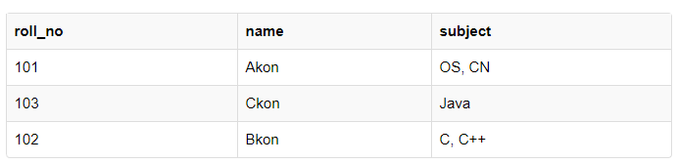
First Normal Form (1NF)
1NF requires that the table only contains atomic (indivisible) values, and that each column contains values of a single type.

Slide 6
Our initial table is already in 1NF as each field contains only atomic values.
StudentID | StudentName | CourseID | CourseName | InstructorID | InstructorName | InstructorPhone
1 | Alice | 101 | Math | 301 | Dr. Smith | 555-1234
2 | Bob | 102 | English | 302 | Dr. Jones | 555-5678
3 | Charlie | 101 | Math | 301 | Dr. Smith | 555-1234
1 | Alice | 103 | History | 303 | Dr. White | 555-8765
2 | Bob | 104 | Science | 304 | Dr. Green | 555-4321

Slide 7
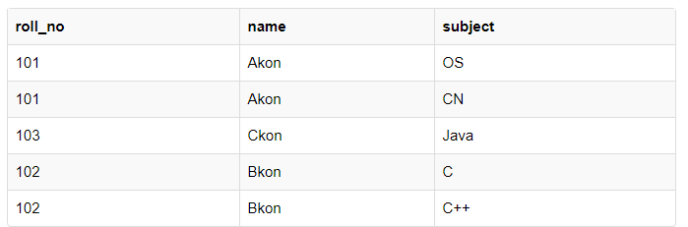
1ST NF

Slide 8
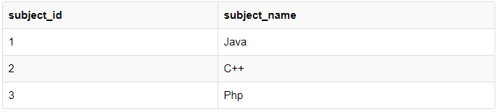
Second Normal Form (2NF)
For a table to be in the Second Normal Form, it must satisfy two conditions:
The table should be in the First Normal Form.
There should be no Partial Dependency.

Slide 9
What is Partial Dependency?
Let's create another table for Subject, which will have subject_id and subject_name fields and subject_id will be the primary key.

Slide 10
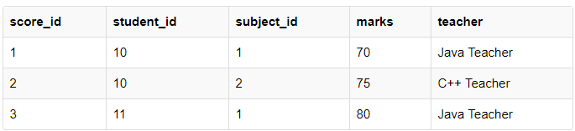
Now we have a Student table with student information and another table Subject for storing subject information.
Let's create another table Score, to store the marks obtained by students in the respective subjects. We will also be saving name of the teacher who teaches that subject along with marks.
See, if I ask you to get me marks of student with student_id 10, can you get it from this table? No, because you don't know for which subject. And if I give you subject_id, you would not know for which student. Hence we need student_id + subject_id to uniquely identify any row

Slide 11
Now as we just discussed that the primary key for this table is a composition of two columns which is student_id & subject_id but the teacher's name only depends on subject, hence the subject_id, and has nothing to do with student_id.
This is Partial Dependency, where an attribute in a table depends on only a part of the primary key and not on the whole key.

Slide 12
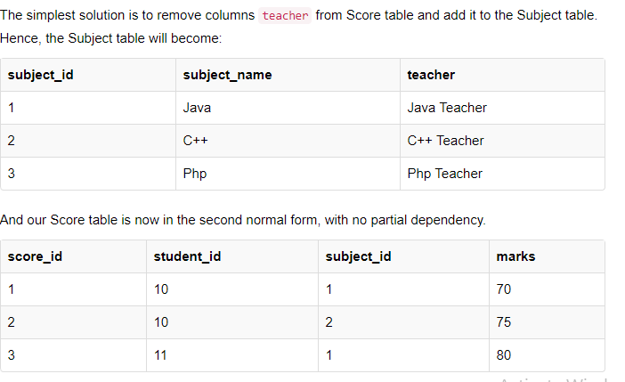
How to remove Partial Dependency?

Slide 13
Third Normal Form
For a table to be in the third normal form,
It should be in the Second Normal form.
It should not have Transitive Dependency.

Slide 14
Transitive Dependency
Transitive Dependency. When a non-prime attribute depends on other non-prime attributes rather than depending upon the prime attributes or primary key.

Slide 15
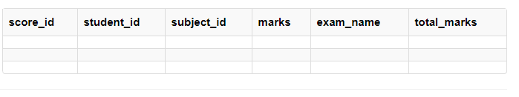
EXAMPLE :
Our new column exam_name depends on both student and subject the column
total_marks depends on exam_name as with exam type the total score changes.
For example, practicals are of less marks while theory exams are of more marks..

Slide 16
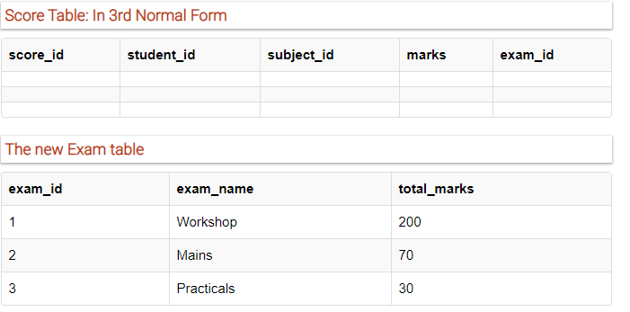
How to remove Transitive Dependency?

Slide 17
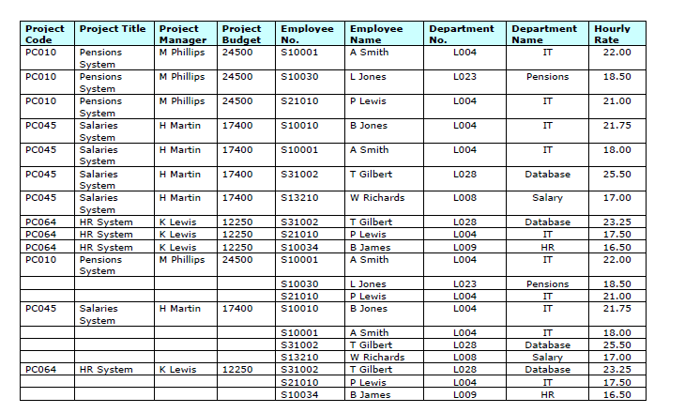
LAB TASK : normalized table

